Slide 1
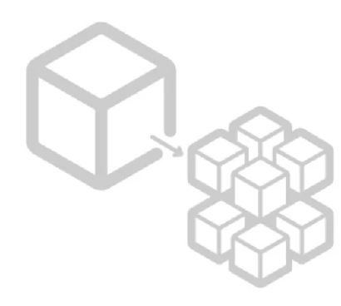
Microservices
Part 3 : Database

Slide 2
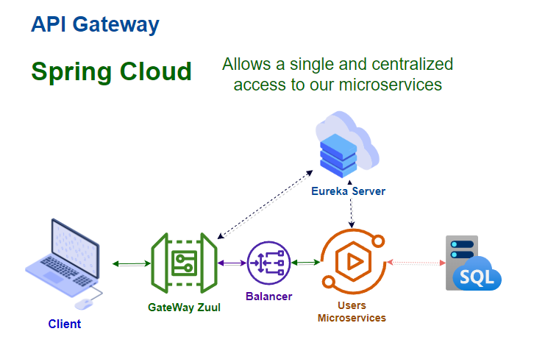
Architecture

Slide 3
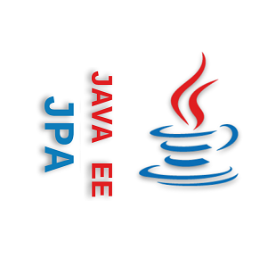
Spring Data JPA
What is JPA?
These are the acronyms for Java Persistence API (JPA).
It is used to persist data between an Java object and relational database.
JPA acts as a bridge between object-oriented domain models and relational database systems.
As JPA is just a specification, it doesn't perform any operation by itself. Is in this way that the Spring Data JPA comes into play as part of the implementation

Slide 4
Spring Data JPA
Spring Data JPA is part of the Spring Data family and makes it easy to implement JPA based repositories. This module deals with enhanced support for JPA based data access layers making it easier to build Spring-powered applications that use data access technologies by reducing the effort with the help of Spring Data interfaces like CrudRepository

Slide 5
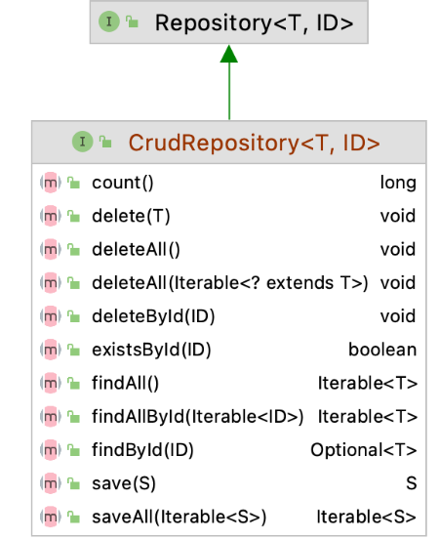
CrudRepository
CrudRepository is a Spring Data interface for generic CRUD operations on a repository and provides several methods out of the box for interacting with a database like as Create,Read,Update and delete methods.
Is necessary to remember that a CrudRepository is just a base interface and it works as an extension to our Repository interface

Slide 6

Let’s implement our data access

Slide 7
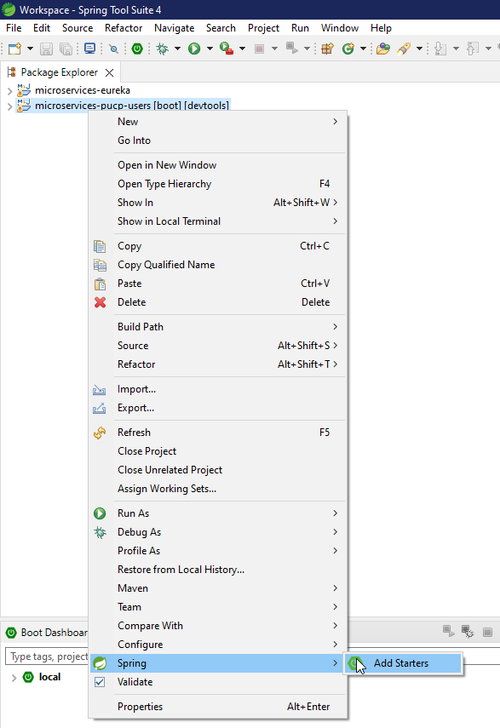
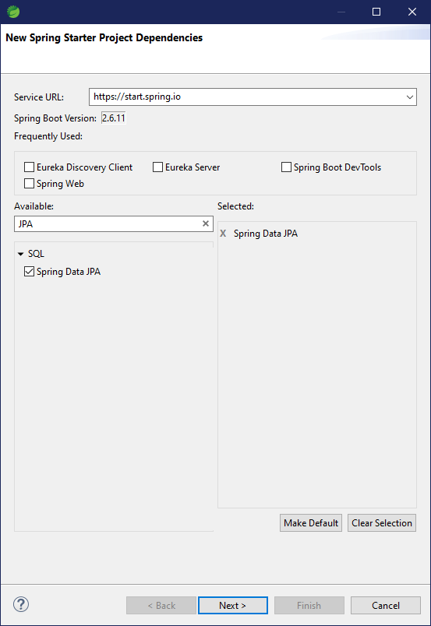
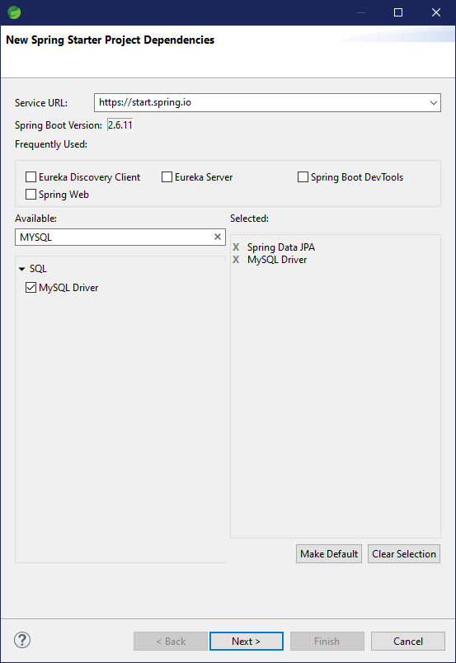
Adding Data dependencies

Slide 8
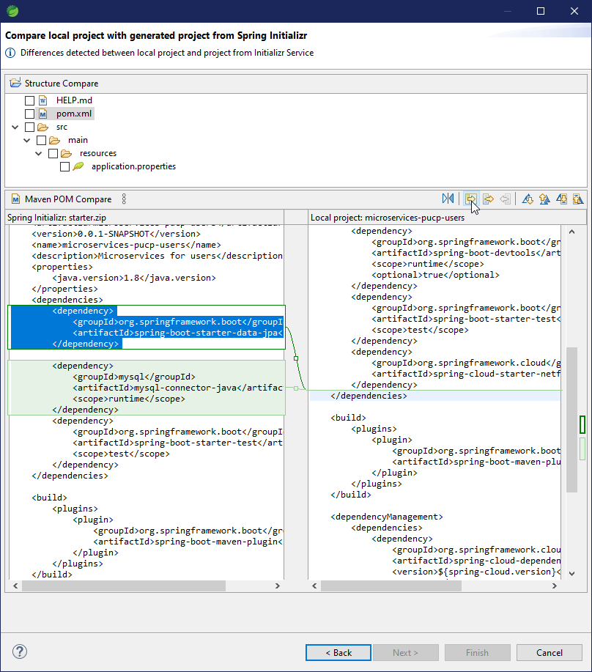
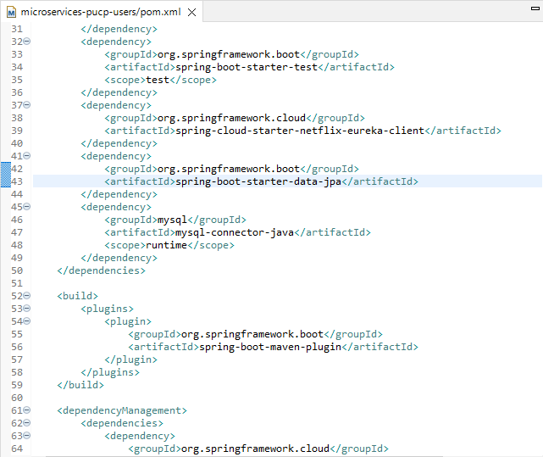
Adding Data dependencies

Slide 9
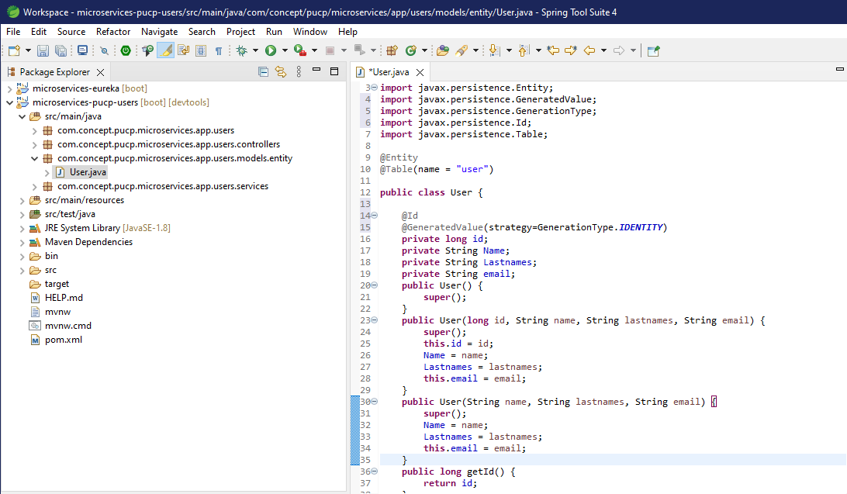
Adding Entity

Slide 10
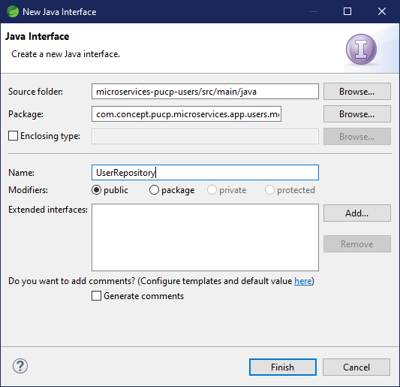
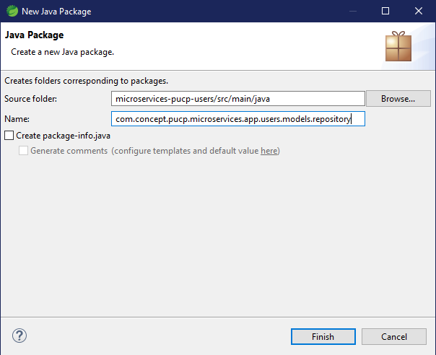
Creating the Repository Entity

Slide 11
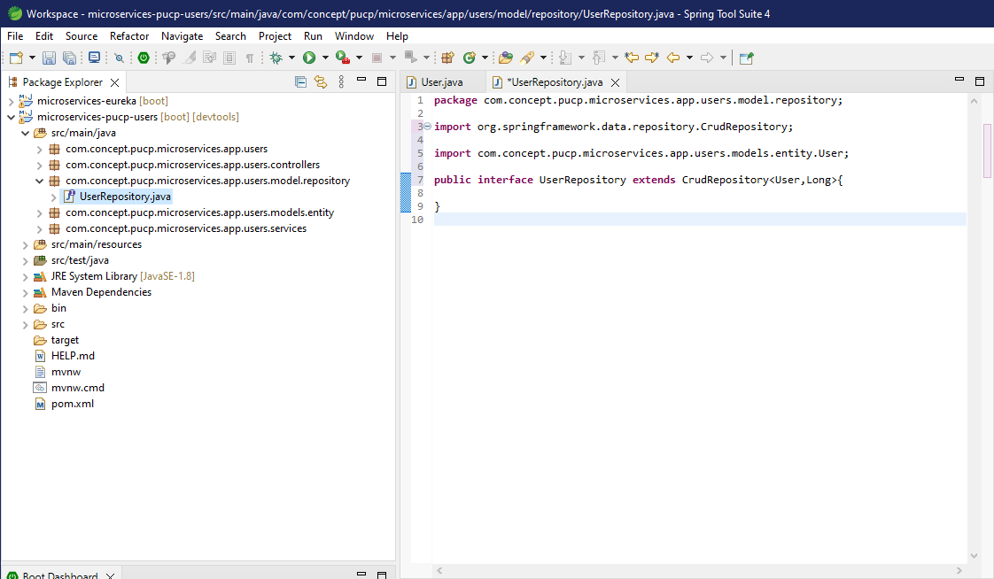
Creating the Repository Entity

Slide 12

Maria DB Configuration

Slide 13
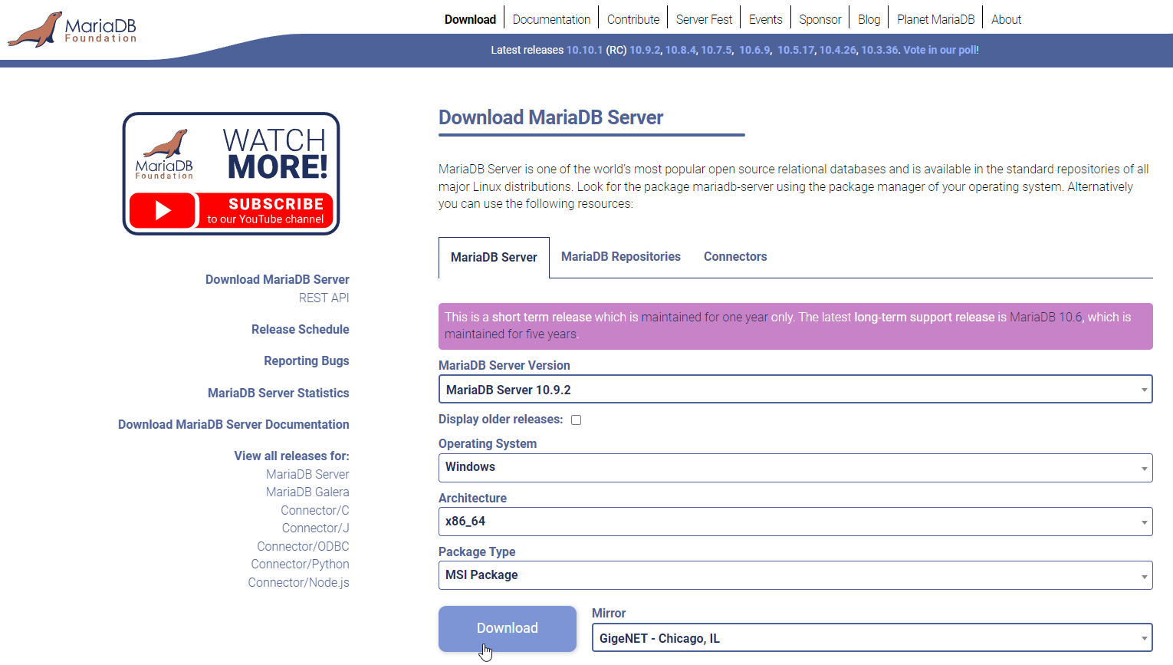
Maria DB Configuration
https://mariadb.org/download/

Slide 14
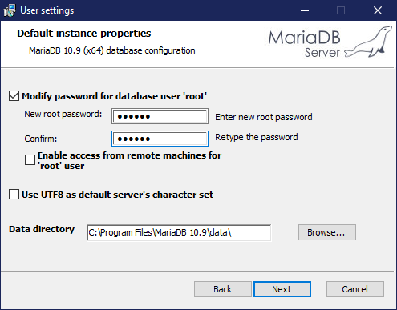
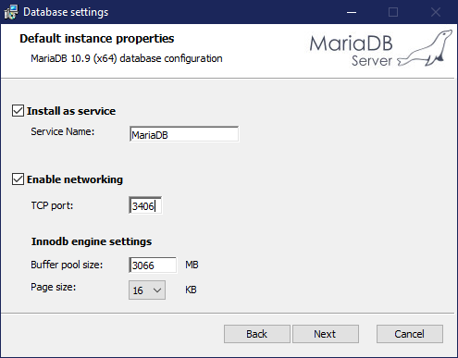
Maria DB Configuration

Slide 15

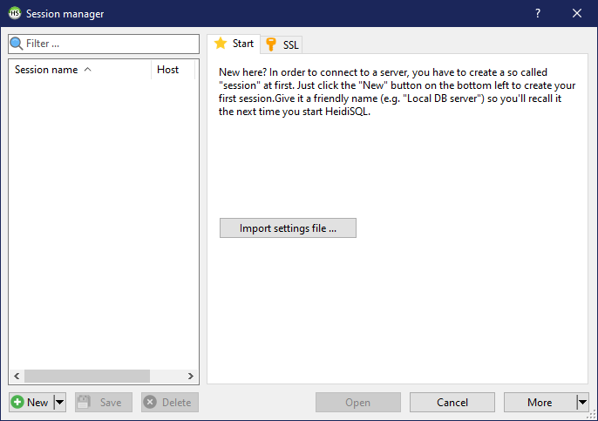
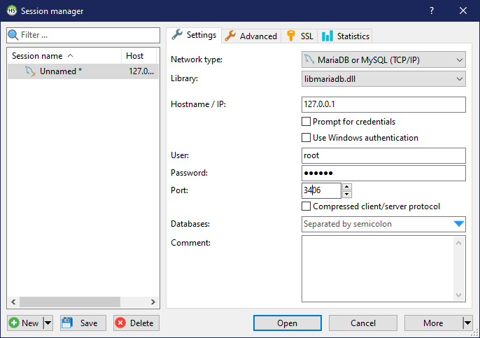
Maria DB Configuration (Open HeidiSQL)
- Click on "New".
- Fill the "Password" field
- Click on "Open".

Slide 16
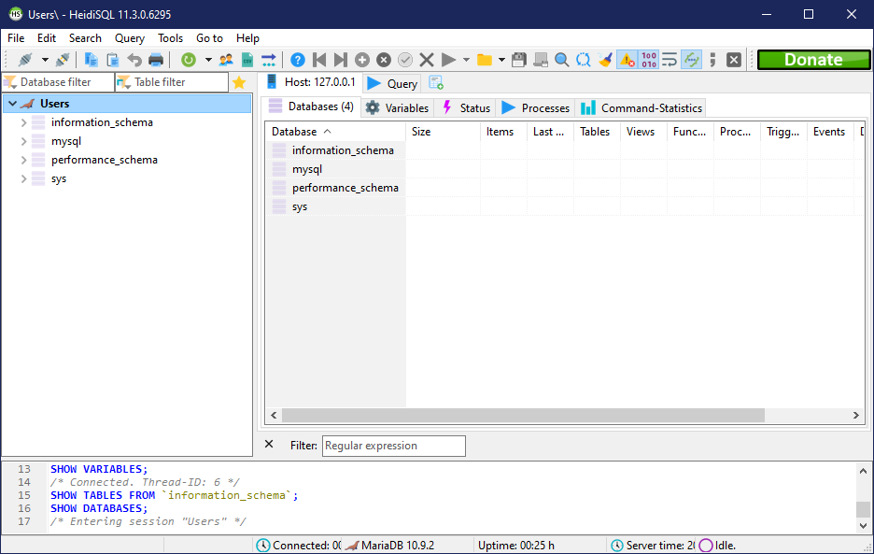
Maria DB Configuration (Open HeidiSQL)

Slide 17
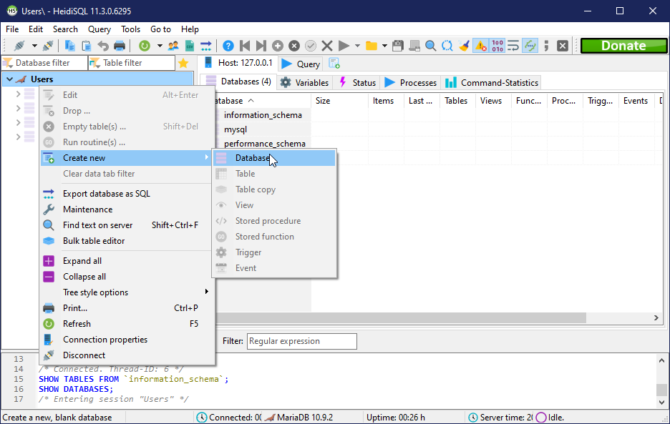
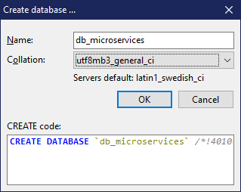
Maria DB Configuration (Open HeidiSQL)

Slide 18
Configuring our microservice

Slide 19
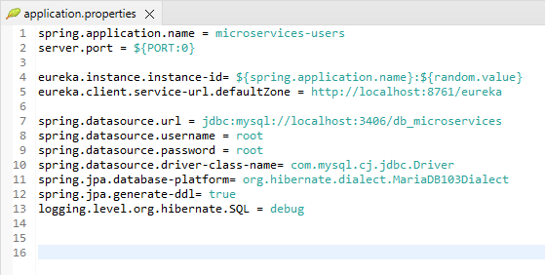
Configuring our microservice

Slide 20
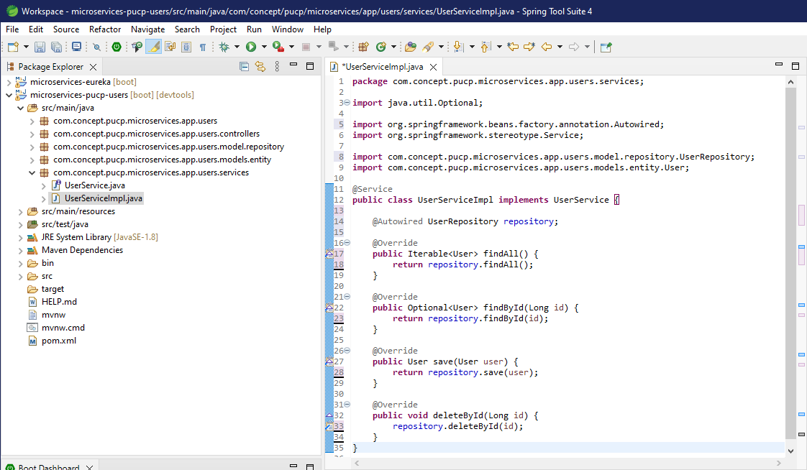
Configuring our microservice

